Slide 2

Who We Are
For over three decades, Vedant Health has provided quality assurance solutions for organizations around the world. We’re a diverse and close-knit team, with deep and extensive experience in the testing technology and healthcare worlds.

Slide 3
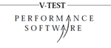




Our History
1986—
We created the first of a new generation of test tools with the award-winning V-TEST product set. The V-TEST innovation continues today under the OpenSTA open source product.
1996—
We started testing healthcare systems and found that the typical test tool and script approach could not handle the complexities of healthcare systems. TestStream and its revolutionary intelligence system launched.
2005—
Moving on from validating airline, banking, insurance, government and space-destined systems, we made
the commitment to concentrate exclusively on healthcare.
2014—
Vedant Health is reborn, bringing a fresh approach to quality management. In its 12th generation, TestStream continues to validate healthcare systems throughout the world.
2020—
Vedant Health continues to provide easy-to- use, comprehensive testing and quality management solutions for Epic, SCC Soft, Cerner, and Sunquest healthcare systems globally.

Slide 4
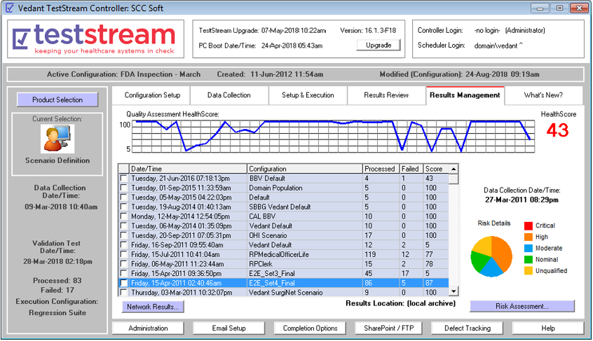
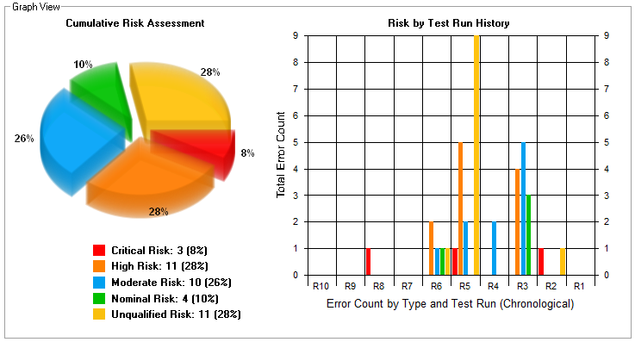

Quality Management
The Cumulative Risk Assessment shows the current state of issues, and their effect on patient safety following a round of testing.
The TestStream HealthScore system allows the quality of the system to be monitored over time, allowing historical results to show times when quality issues were noted.

Slide 5
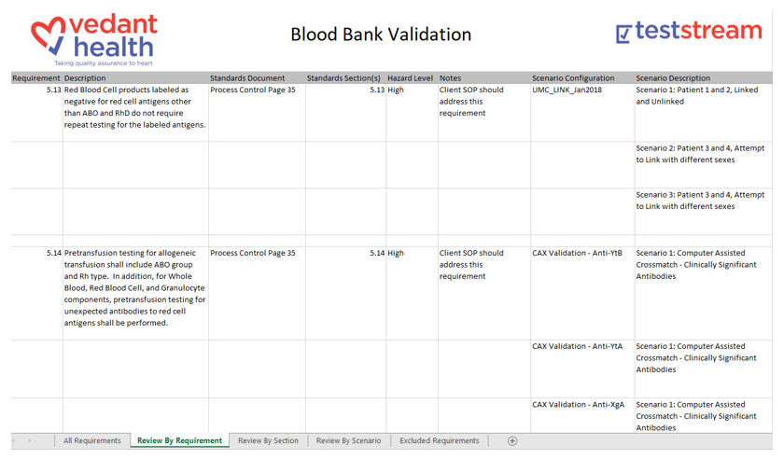
AABB Guidelines - BBV Matrix
Every validation is designed based on the facility and the latest AABB requirements. These are linked to results, creating a “map” of the validation.
This map is included as a true BBV matrix, along with the screen prints, issue details, and pass/fail reports.

Slide 6
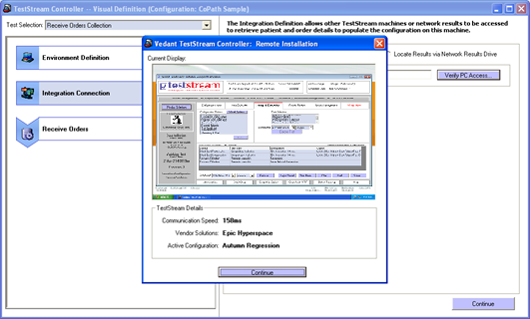

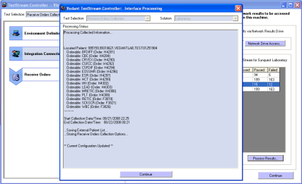
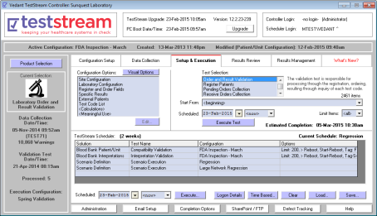
Integration Testing Built-In
Included Integration Functionality
Every TestStream installation includes our unique integration system. This allows automatic results and knowledge sharing between multiple vendor systems…
For Example:
Epic > SCC Soft > Epic
Cerner > Sunquest> Cerner
Cerner > Sunquest > Epic
Epic > Cerner > Epic
Cerner > Epic > Cerner

Slide 7
Why TestStream…?
Why is TestStream so different from other automated testing products?
No scripting or programming required for any site
Automatically supports all versions of vendor systems
Integration testing, covering multi-vendor systems
Domain population for testing and training purposes
Going beyond testing with analysis and review features
Community-Based Enhancements automatically installed for free
The most important factor… Technology & People

Slide 8
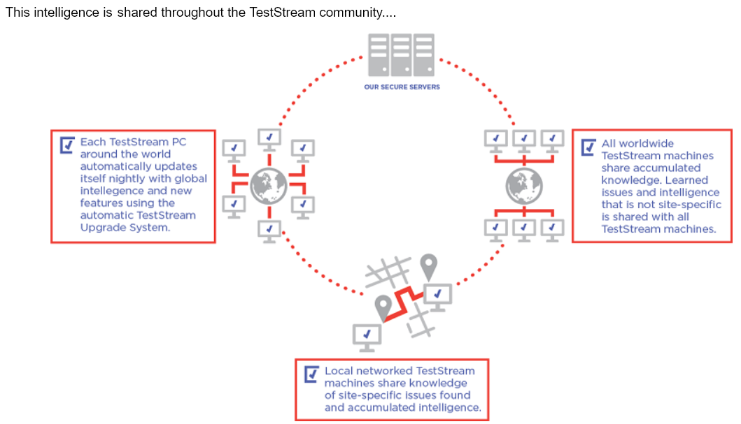
Technology…
TestStream has been designed from the ground up to be intelligent and independent.
With no scripting, all vendor versions are supported, and regression testing is practical.
This is the true definition of reliable automation.

Slide 9
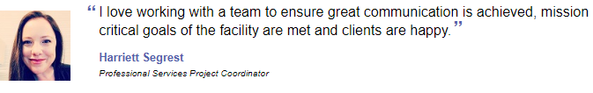

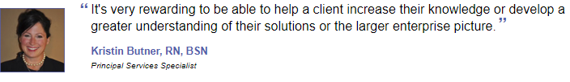
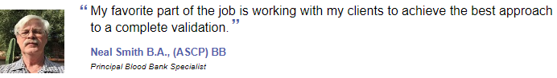
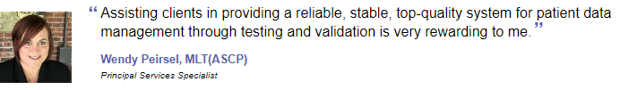
People…
* just a sample of our seasoned staff

Slide 10
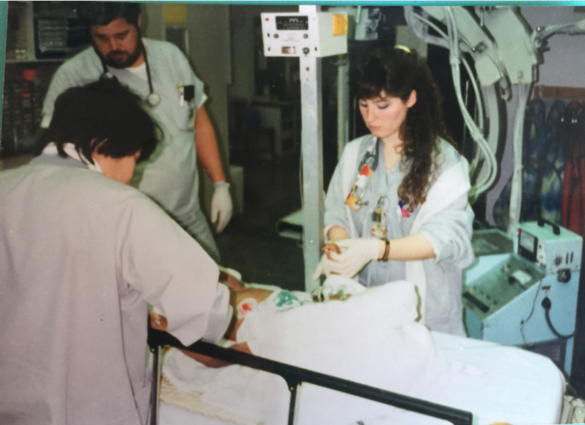





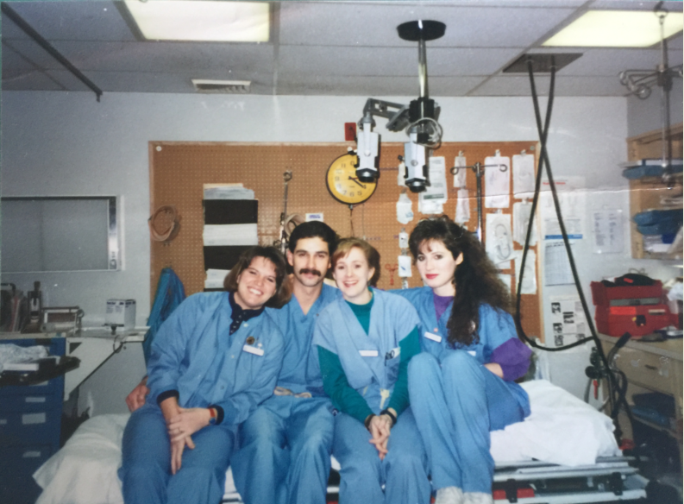

Seasoned Professionals

Slide 11
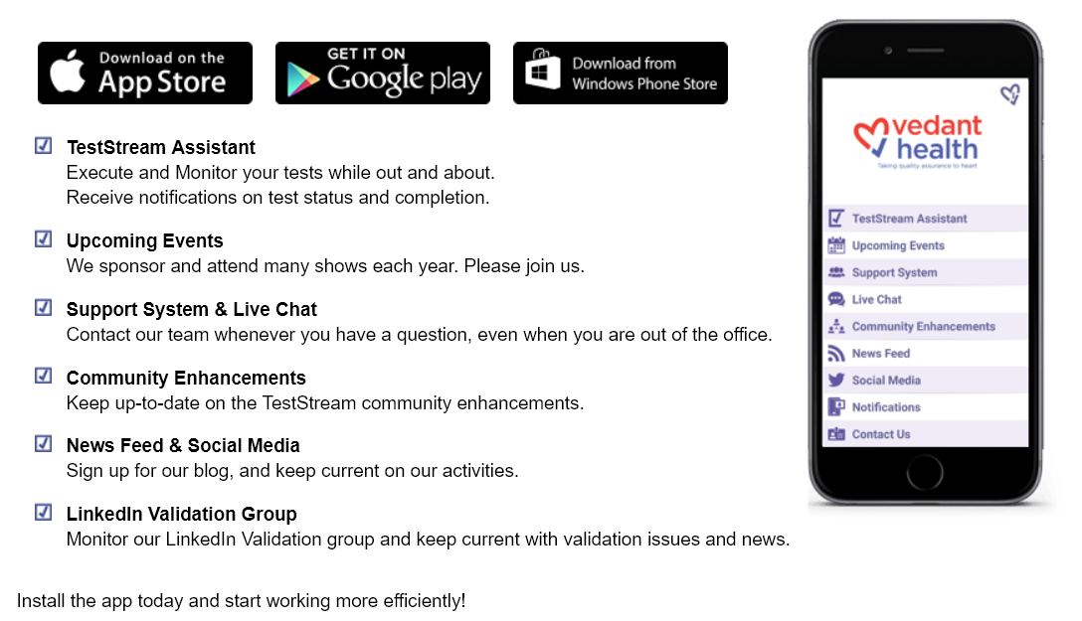
Testing on the Go!

Slide 12

Our Philosophy
“Nobody cares how much you know, until they know how much you care.”
– Theodore Roosevelt
“Quality is never an accident. It is always the result of intelligent effort.”
– John Ruskin

Slide 13
Our Mission
Testing and validation technology is what we do. But what’s at the heart of our mission — and always has been — is a passion for helping healthcare organizations save and improve their patients’ lives.

